Slide 1
Meta Label Correction for Noisy Label Learning
Xiaoyu Li
12.22

Slide 2
Background
Large amounts of annotated data is not readily available at scale for many tasks.
Weak supervision:
Incomplete supervision
Inexact supervision
Inaccurate supervision

Slide 3
Motivation
One of the limitations of label re-weighting is that it is limited to up or down weighting the contribution of an in- stance in the learning process. (Not using all of data for training)
Previous methods of label correction rely on assumptions about the weak label generation process and thus often involves two independent steps: (1) estimating a label corruption matrix , (2) training a model on the noisy data leveraging the corruption matrix. (assumptions about the noise generation process)

Slide 4




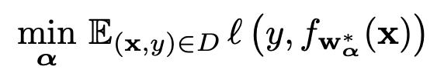
Method
Clean data weak(noisy) data M>>m
Meta Model: label correction network (LCN)
Main Model:
bi-level optimization problem:

Slide 5
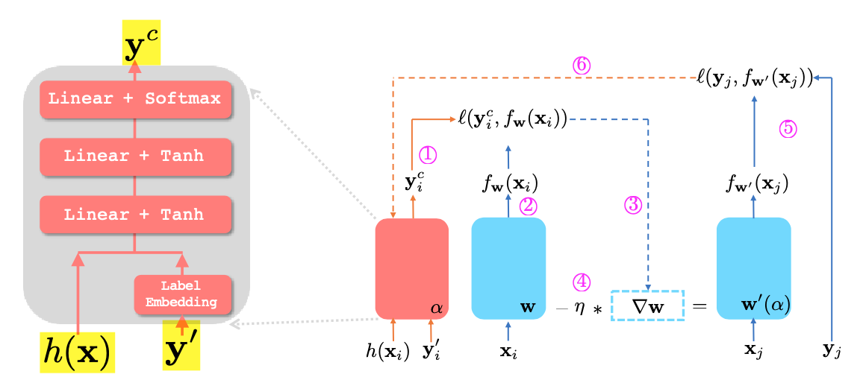
Method
Feed the weak instance to the LCN and get its corrected label
Feed the data instance to the current classifier and compute the logits for prediction
Compute the loss with the logits and corrected label, and compute the gradient of the loss with respect to the parameter of the classifier. Note that the gradient will be a function of the parameters of the LCN.
Update the classifier parameter while keeping the computation graph for the gradient
feed a pair of clean instance to the new model and compute its loss
Compute the gradient of the loss w.r.t the parameter to LCN and update the LCN

Slide 6




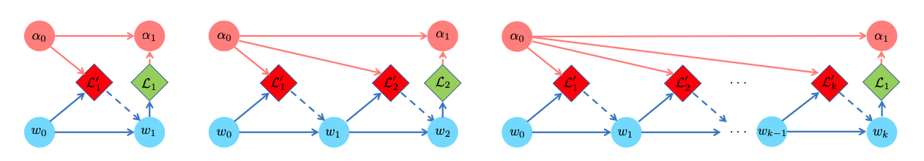
Method - Gradient-based optimization
Look one step ahead
K step ahead
Main Loss
Meta Loss

Slide 7
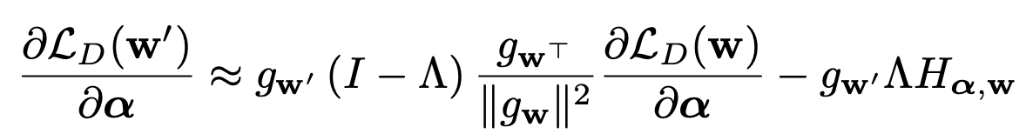

Method - Gradient-based optimization
K step ahead
Approximation:
w′ is the model parameter for next step,
g_{w} is a short hand for the gradient of the training loss w.r.t w,
Λ is a diagonal matrix representing the current learning rates for all parameters in w,
H_{α,w} is a short hand for

Slide 8
Method – soft labels
Soft labels are crucial in MLC as they make gradient propagation back to the meta model from the main model possible
It brings difficulty to training due to the additional uncertainty in the corrected labels
Solution: In training for each batch of clean data, we split it into two parts, with one serving as the clean evaluation set and add the other to the training process for f , as a small portion of the clean set will provide clean guidance for training, to ease model training.

Slide 9
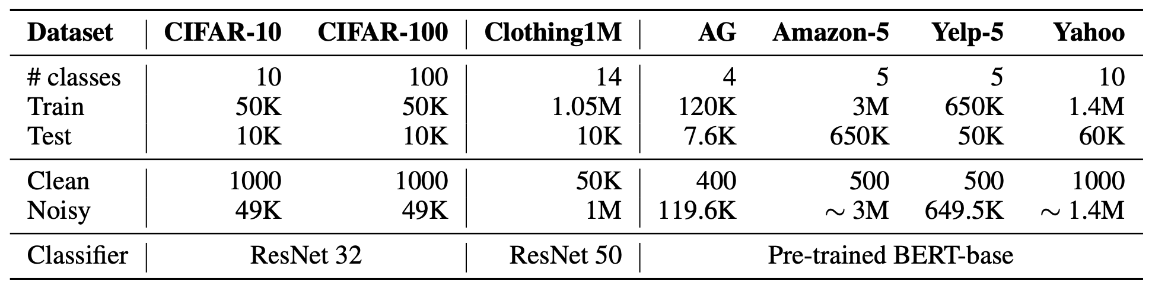
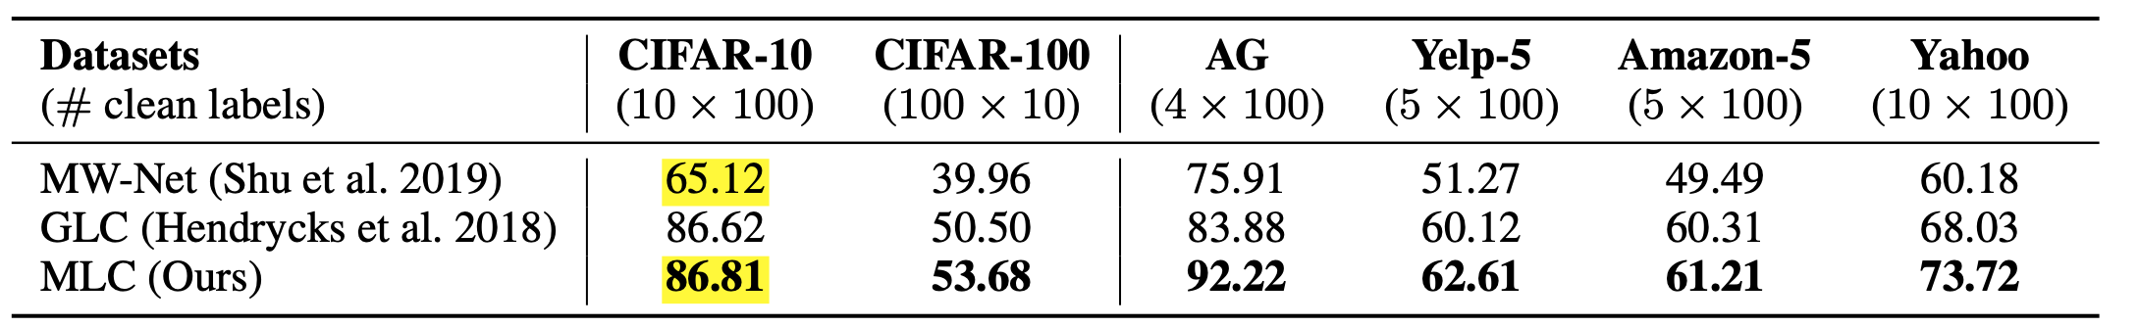
Experiments

Slide 10
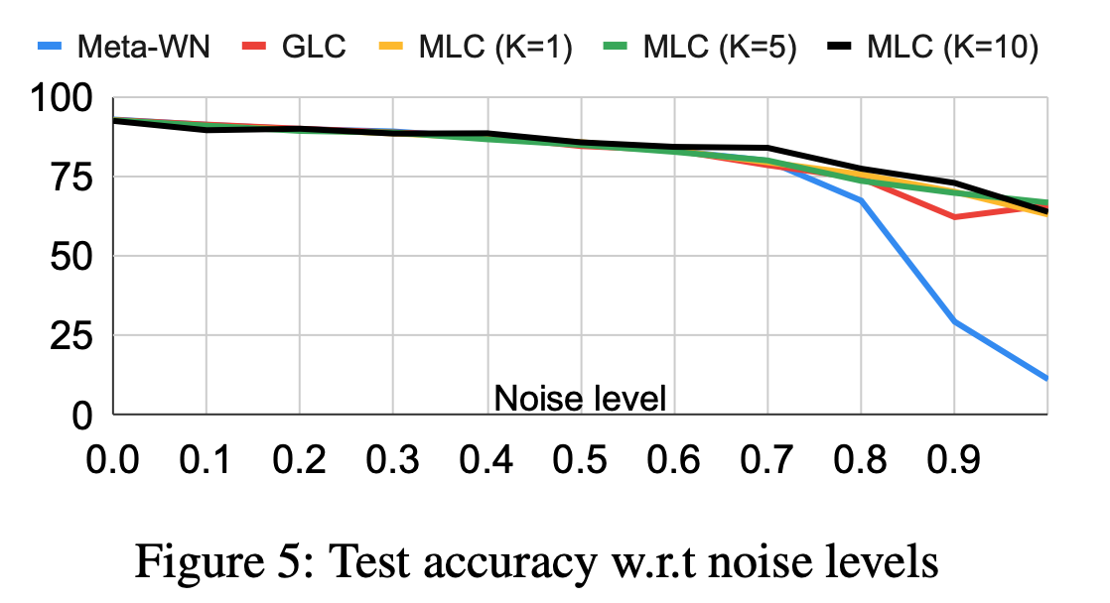
Experiments
UNIF noise

Slide 11
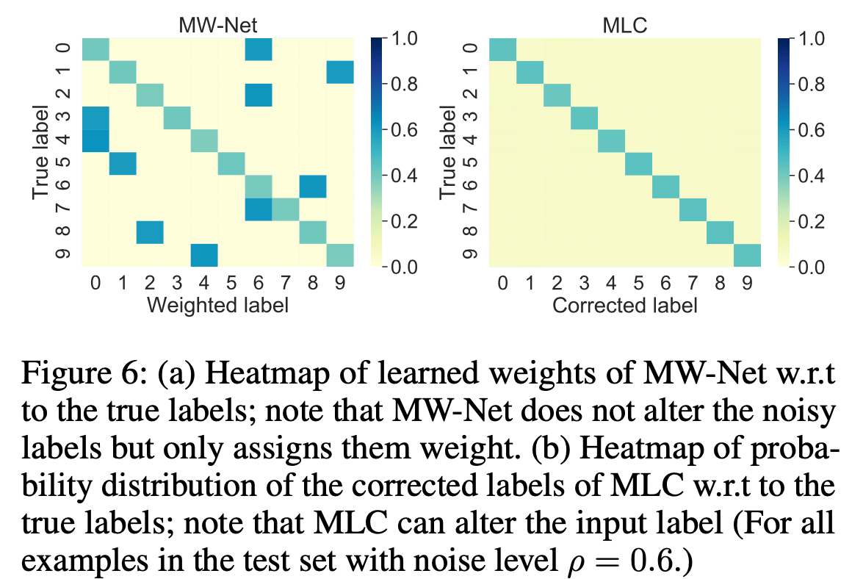
Experiments

Slide 12
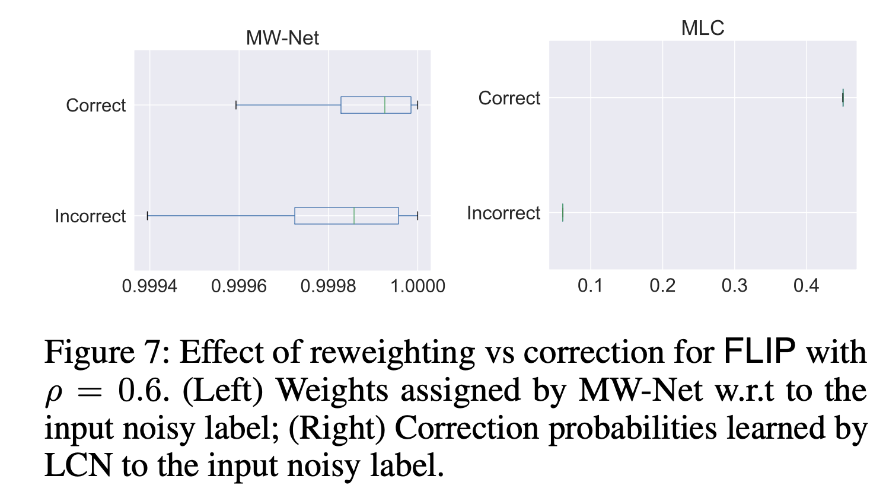
Experiments

Slide 13
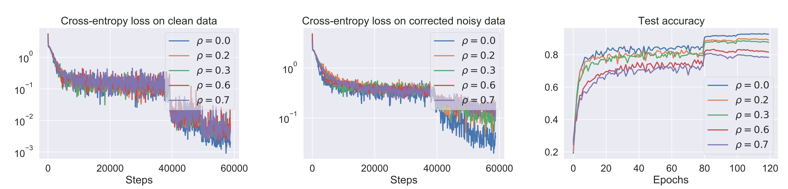
Experiments

